Slide 1
Magic Methods

Slide 2
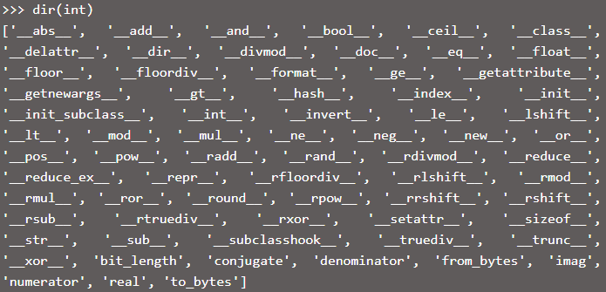
Dunder or Magic Methods
These methods have two prefix and suffix underscores in the method name
Dunder : Double Under score
Built-in classes in Python define many magic methods. It can be checked using dir()
e.g. Int class
Notes:
https://www.geeksforgeeks.org/dunder-magic-methods-python/#:~:text=Dunder%20or%20magic%20methods%20in%20Python%20are%20the%20methods%20having,__%2C%20__repr__%20etc.
https://www.tutorialsteacher.com/python/magic-methods-in-python

Slide 3
Dunder or Magic Methods
Magic methods are not meant to be invoked directly by you, but the invocation happens internally from the class on a certain action.
E.g.
when you add two numbers using the + operator, internally, the __add__() method will be called
The __init__ method for initialization is invoked without any call, when an instance of a class is created
Notes:
https://www.geeksforgeeks.org/dunder-magic-methods-python/#:~:text=Dunder%20or%20magic%20methods%20in%20Python%20are%20the%20methods%20having,__%2C%20__repr__%20etc.
https://www.tutorialsteacher.com/python/magic-methods-in-python

